Slide 1
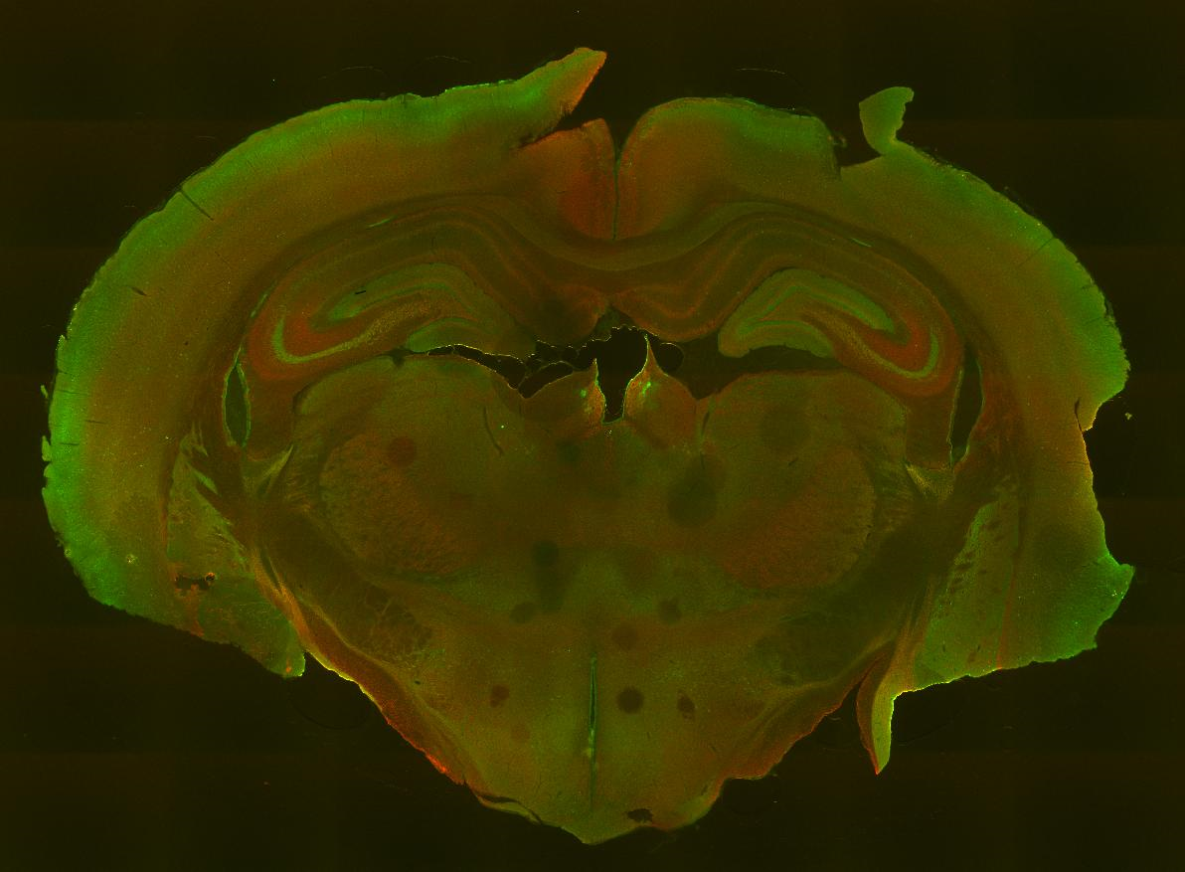
Genetically Encoded Labeling Strategies
Kurt Thorn
Nikon Imaging Center, UCSF

Slide 2
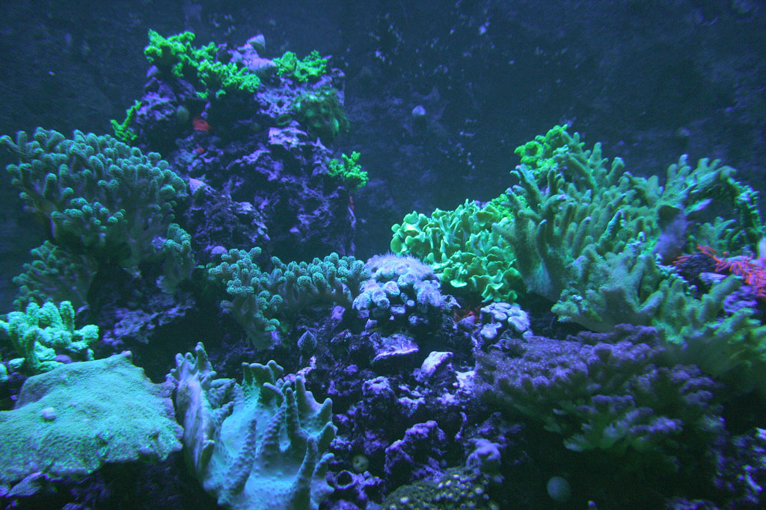
Naturally occurring fluorescent proteins
Fabio Gismondi / Flickr

Slide 3
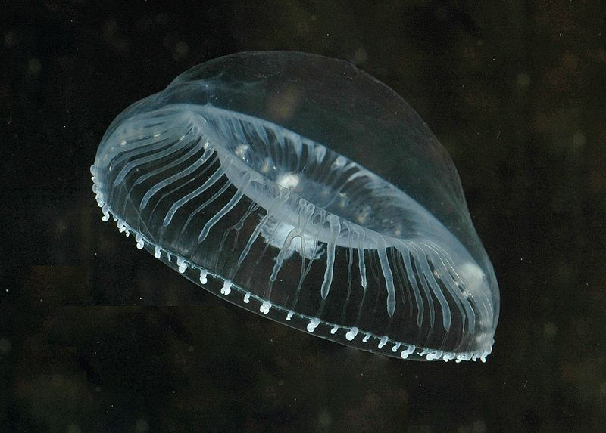
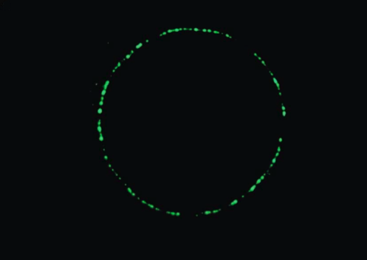
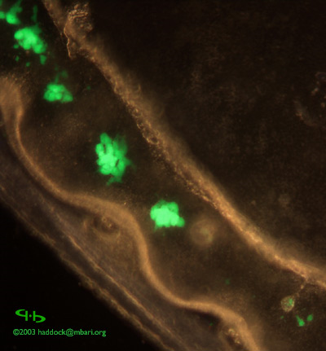
Aequorea victoria

Slide 4
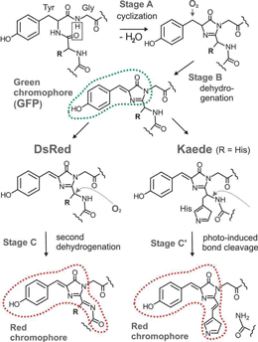
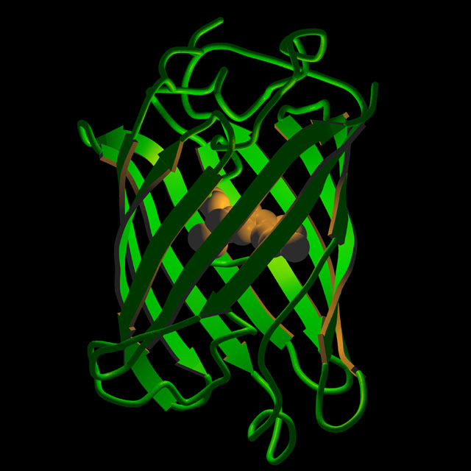
Protein and chromophore structure

Slide 5
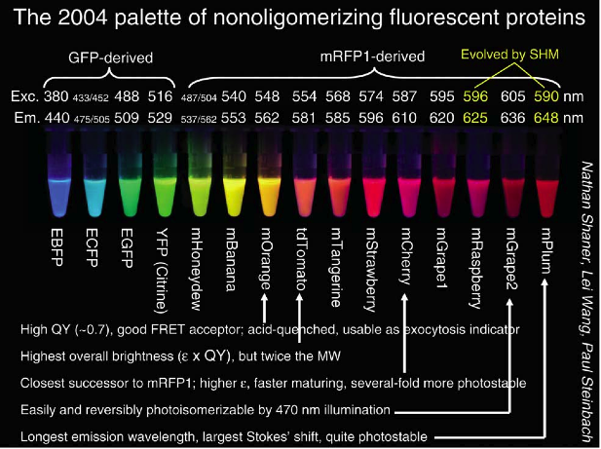

Slide 6
General fluorescent protein info
Monomer size: ~ 240 a.a.; 27 kDa
Many have been engineered from dimeric or tetrameric proteins and may have residual oligomerization
For GFP variants, A206K ensures monomer
Require oxygen for maturation
Maturation takes ~15 min to hours

Slide 7
How to evaluate a fluorescent protein?
Excitation and emission wavelengths
Compatible with filters / lasers?
Separable from other FPs / dyes?
Brightness
Maturation rate
May depend on organism and temperature
pH / environment sensitivity
Oligomerization state
Does it perturb fusion protein function?

Slide 8
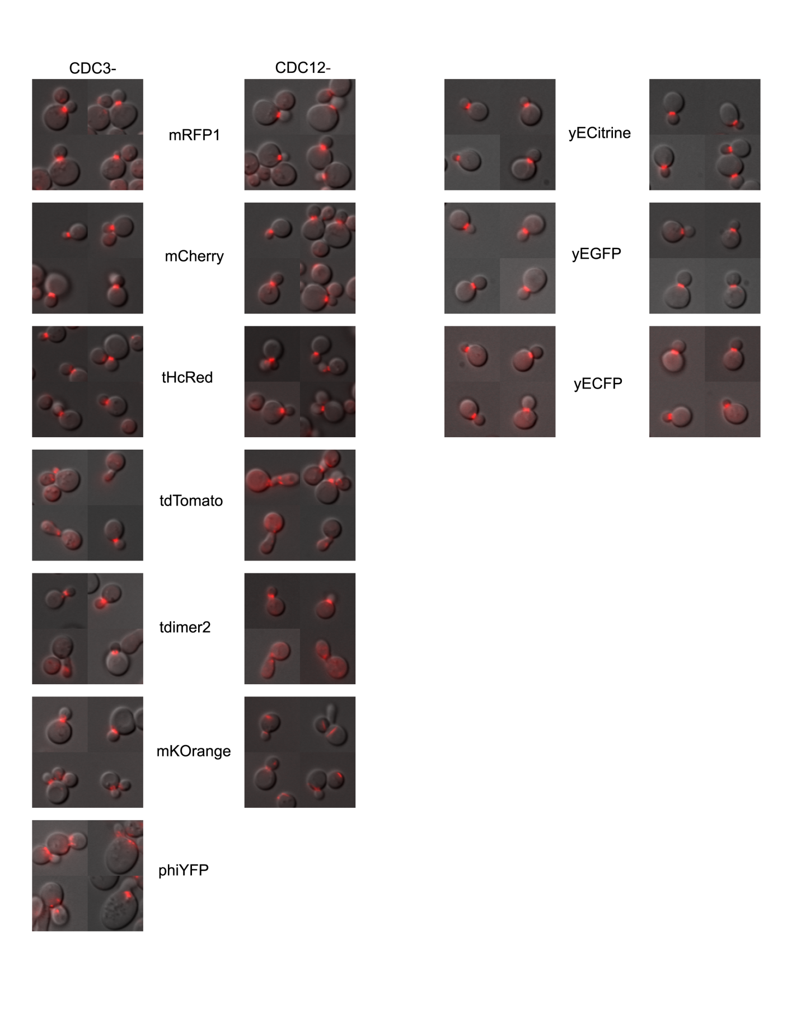
Perturbation of fusion proteins

Slide 9
Good FP combinations
Blue / Green / Red / near IR
For 405 / 488 / 561 / 640 lasers
(like DAPI / Fluorescein / Rhodamine / Cy5)
Cyan/ Yellow / Red / near IR
Good for CFP/YFP FRET

Slide 10
Recommended Blue FPs
mTagBFP: 499 ex / 454 em Brightness 32
Well-matched to 405nm laser
EBFP2: 383 ex / 448 em Brightness 18
more photostable than mTagBFP

Slide 11
Recommended Cyan FPs
ECFP derived:
mTurquoise2: 433 ex / 474 em Brightness 28
SCFP3A: 433 ex / 474 em Brightness 17
Folds better than Cerulean and ECFP
Others:
mTFP1: 462 ex / 492 em Brightness 54
TagCFP: 458 ex / 480 em Brightness 21

Slide 12
Recommended Green FPs
EGFP derived:
EGFP: 488 ex / 507 em Brightness 34
mEmerald: 487 ex / 509 em Brightness 37
Clover: 505 ex / 515 em Brightness 84
Others:
mWasabi: 493 ex / 509 em Brightness 56
mTFP1 derivative
mNeonGreen: 506 ex / 517 em Brightness 93

Slide 13
Recommended Yellow FPs
EYFP derived:
mCitrine: 516 ex / 529 em Brightness 58
SYFP2: 515 ex / 527 em Brightness 69
Improved Venus

Slide 14
Recommended Red FPs
DsRed derived:
mCherry: 587 ex / 610 em Brightness 16
mApple: 568 ex / 592 em Brightness 37
TagRFP-T : 555 ex / 584 em Brightness 33
mRuby2 : 559 ex / 600 em Brightness 43
mKate2 : 588 ex / 633 em Brightness 25

Slide 15
Recommended Far-Red / near-IR FPs (Capable of 640nm excitation)
Intrinsically fluorescent:
TagRFP657: 611 ex / 657 em Brightness 3
Biliverdin co-factor:
IFP1.4: 684 ex / 708 em Brightness 8
iRFP: 690 ex / 713 em Brightness 6
dimeric

Slide 16
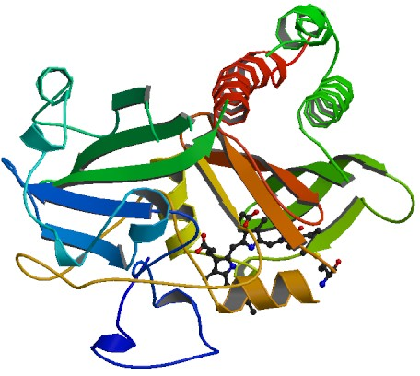
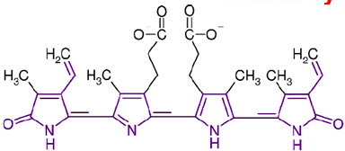
IFP1.4
Chromophore: biliverdin Ixa
Product of heme breakdown
Membrane permeable
321 aa; 36.5kDa
Typically fluorescent in mammalian cells but adding exogenous biliverdin increases fluorescence ~5-fold

Slide 17
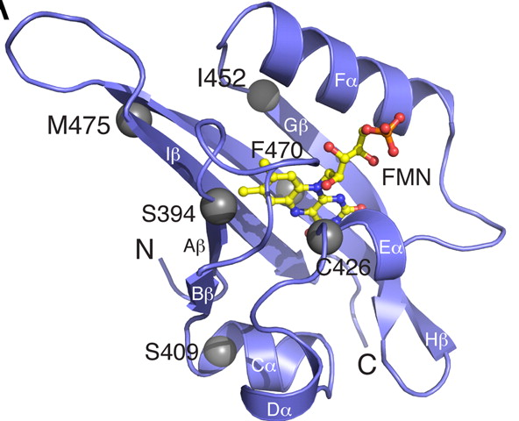
iLOV / phiLOV2.1
Flavin-binding plant protein
GFP-like fluorescence
10kD - about half the size of GFP

Slide 18
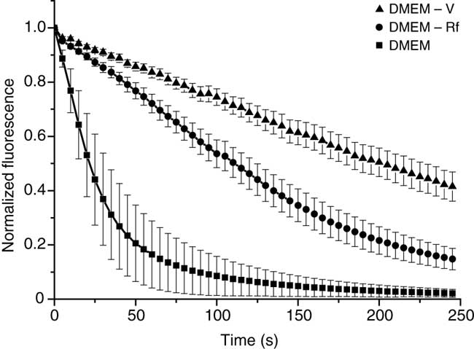
GFP Bleaching in Live Cells
Riboflavin and pyridoxal are bad, but do not affect RFPs
Bogdanov et al., Nat. Meth. 6 p859 2009

Slide 19
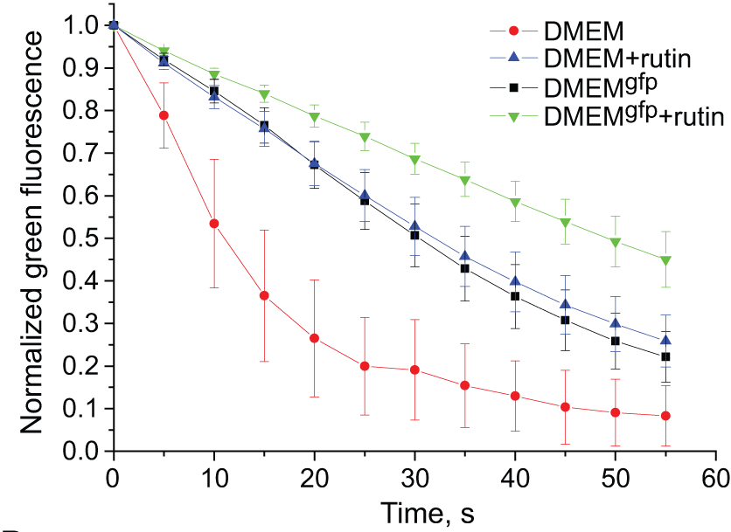
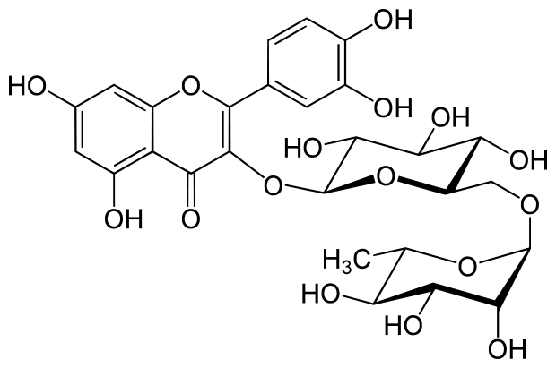
GFP Bleaching in Live Cells
Incubation of cells with rutin 30 minutes prior to imaging increases photostability

Slide 20
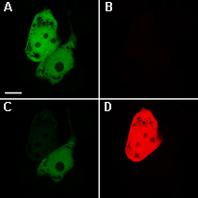
Optical Highlighter Proteins
Photoactivatable (Off → On)
PA-GFP, PAmCherry
PATagRFP
Photoswitchable (Color change)
Kaede, KikGR, Eos,
Dendra (activatable by blue)
PS-CFP
Photoswitchable (Off ↔ On)
asCP, KFP (tetrameric)
Dronpa
Dendra2 demo
green
red
Activate
before
after

Slide 21
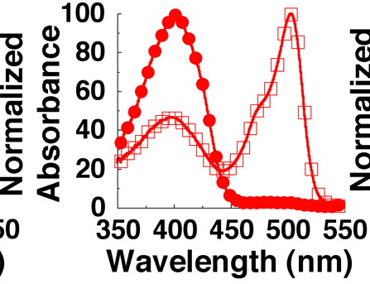
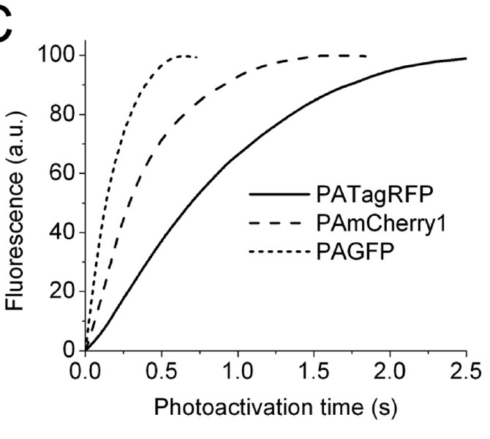
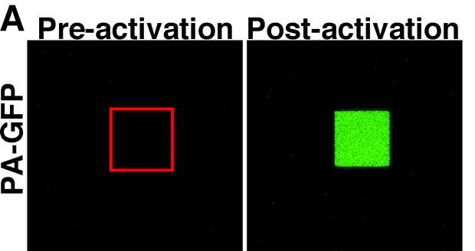
Photoactivation
Pre-activation
Post-activation
Generally: Off
405 nm
On
Science 2002 297: 1873-1877

Slide 22
Recommended Photoactivatable Proteins
PAGFP: 504 ex / 517 em Brightness 14 Contrast 100
PAmCherry: 564 ex / 595 em Brightness 8 Contrast 4000
PAtagRFP: 562 ex / 595 em Brightness 25 Contrast 500

Slide 23
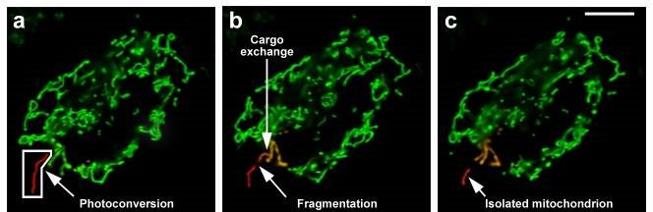
Photoconversion
405 nm
Generally: Green
Best monomer is probably mEos2; multiple tetrameric proteins available
mEos2 (green): 506 ex / 519 em Brightness 47
mEos2 (red): 573 ex / 584 em Brightness 30 Contrast 2000?
Red
McKinney et al. Nature Methods 6, 131–133 (2009)

Slide 24
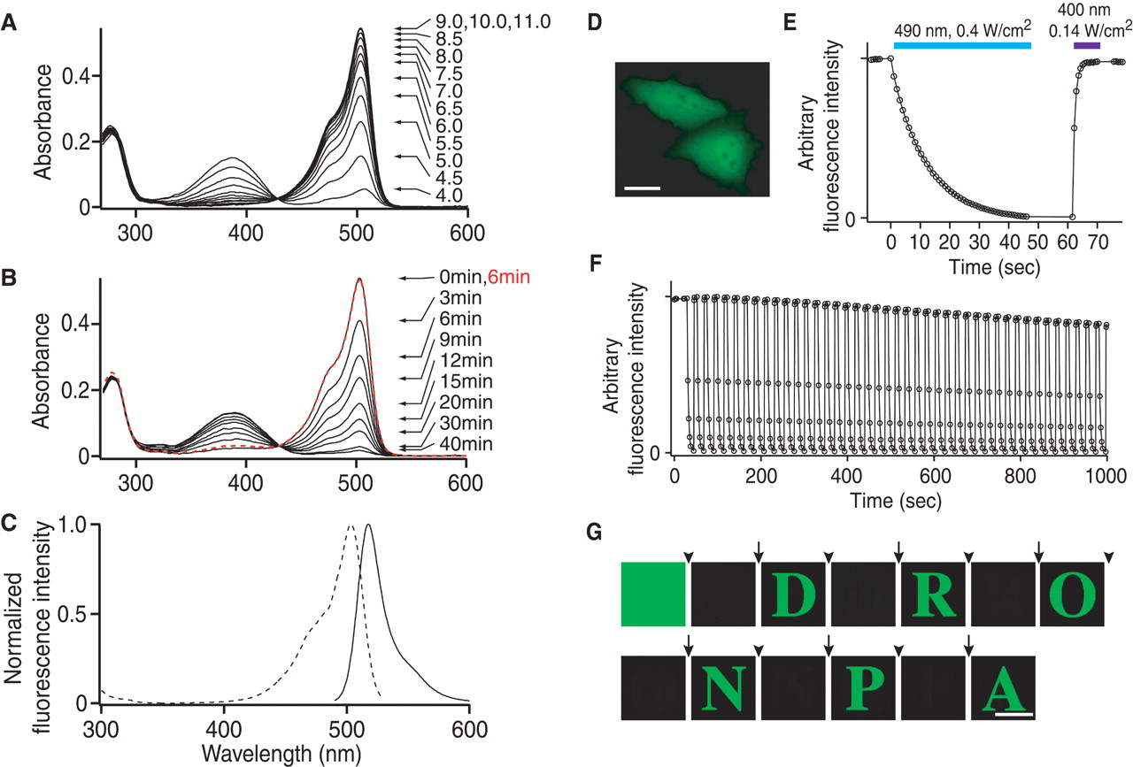
Photoswitchable – Dronpa
Generally: Off
405 nm
On
λ_{ex}
Ando et al. 2004, Science 306: 1370-1373

Slide 25
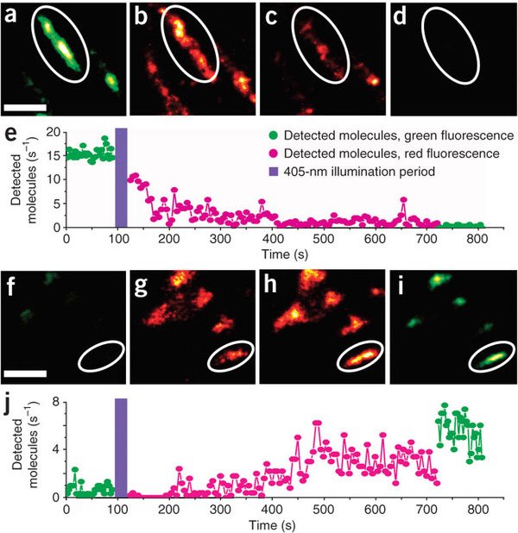
mIrisFP – Photoswitchable and Photoconvertible
Green
405
Red
488
405
532
440
Off
Off
Eos derivative
Both green and red states are decently bright
Fuchs et al. Nature Methods 7, 627–630 (2010)

Slide 26
Fluorescent proteins – pros / cons
Can be easily introduced into live cells
Minimally perturbative
Photoactivatible/photoconvertible versions exist
Avoids fixing / staining
Require genetically tractable system
Folding and maturation can be slow
Some are pH and Cl⁻ sensitive
Some have very complicated photophysics (strange photoactivation / photobleaching behavior)

Slide 27
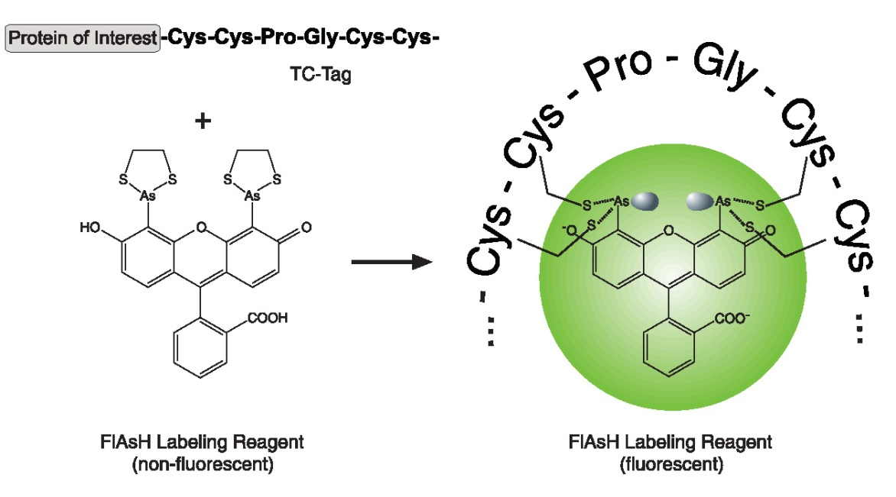
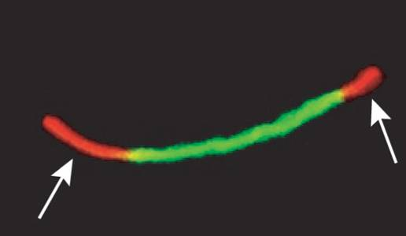
FlAsH/ReAsH
Labeling protein with tetra-cysteine motifs:
Newly synthesised connexins (ReAsH:Red) are added to the outer edges of existing gap junctions (FlAsH:Green).
Gaietta et al 2002
Commercially available from Invitrogen as Lumio or TC-FlAsH II / TC-ReAsH II

Slide 28
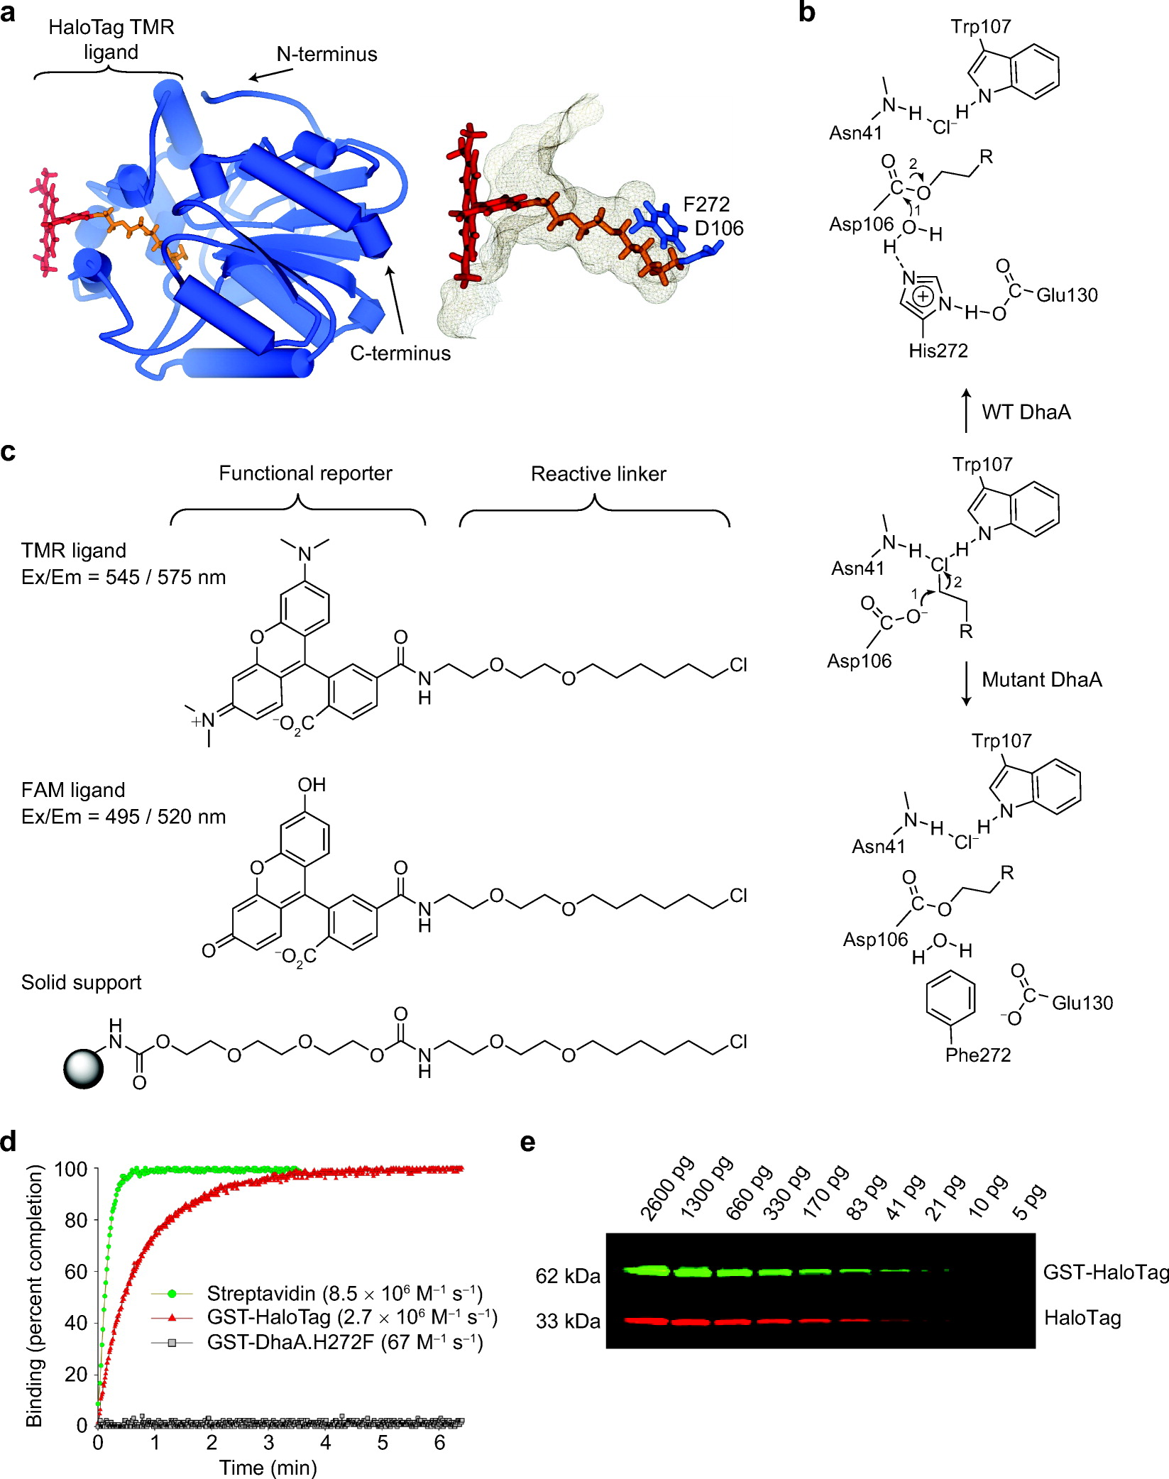
Covalent attachment of dyes to genetic tags
HaloTag (Promega)
Modified haloalkane dehalogenase
~31 kDa

Slide 29
Covalent attachment of dyes to genetic tags
SNAP- and CLIP-tags (NEB)
Modified O⁶-alkylguanine-DNA alkyltransferase; ~20 kDa

Slide 30
Advantages of HaloTag / SNAP-Tag fusions over GFP:
Same protein can be labeled with almost anything you want
Easy to couple ligands to any NHS or malemide compound
Many dye/biotin ligands commercially available
Label same protein in different colours (avoid recloning)
Label different compartments
Cell-permeable and impermeable probes available
Pulse chase experiments
Add two different dyes at different time points

Slide 31
Dye-binding antibodies
Single chain antibodies (scFv) that bind dye molecules
Dyes are only fluorescent in their bound state
10,000-fold activation possible
Different scFvs bind different dye families
Can do multicolor labeling
But multiple color dyes can bind same scFv
14 – 26 kDa
Commercially available from Spectragenetics.com

Slide 32
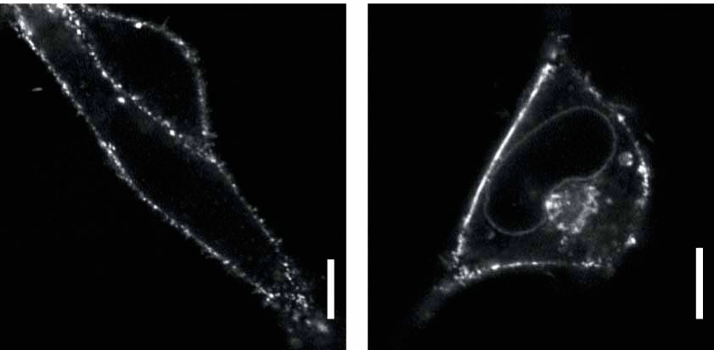
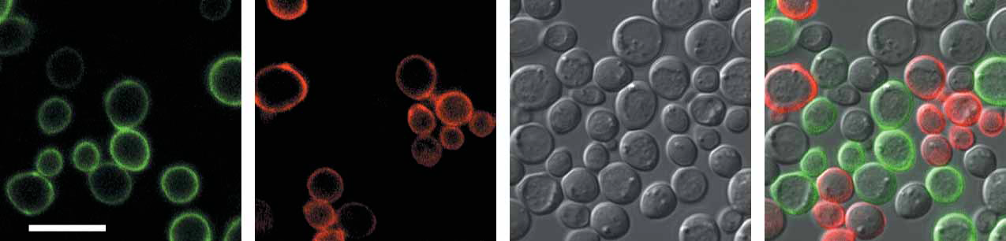
Dye binding antibodies
Membrane impermeant dye
Membrane permeable dye

Slide 33
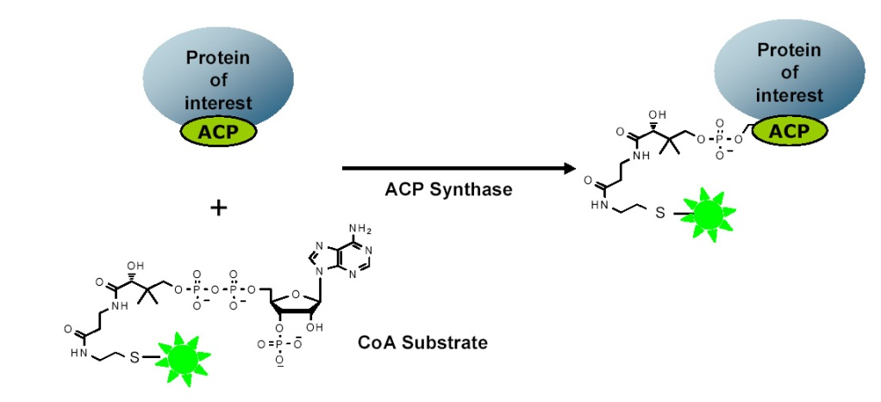
Enzyme catalyzed labeling
ACP/SFP synthase (NEB)
Genetic Tags:
ACP / MCP Tag (77aa)
YbbR peptide (11aa) (Christopher Walsh)

Slide 34
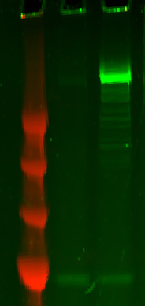
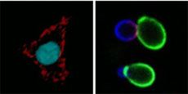
Uses of enzyme catalyzed labeling
1) Site specific labeling of proteins with short peptides
-YbbR +YbbR
Artificial dimerised dynein with and without YbbR peptide labelled with SFP synthase and 547-CoA (Vale lab)
250kD
150kD
100kD
75kD
2) Labelling of cell surface proteins

Slide 35
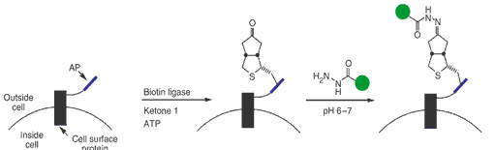
Enzyme catalyzed labeling
Biotin and Lipoic Acid Ligase (Alice Ting)
Biotin or keto-biotin labeling
Ketone group can be specifically labeled
Not yet commercially available

Slide 36
Further Reading
http://nic.ucsf.edu/dokuwiki/doku.php?id=fluorescent_proteins
Nico Stuurman
Mike Davidson
Acknowledgements

